Slide 1
Data Structures – 2D Arrays

Slide 2
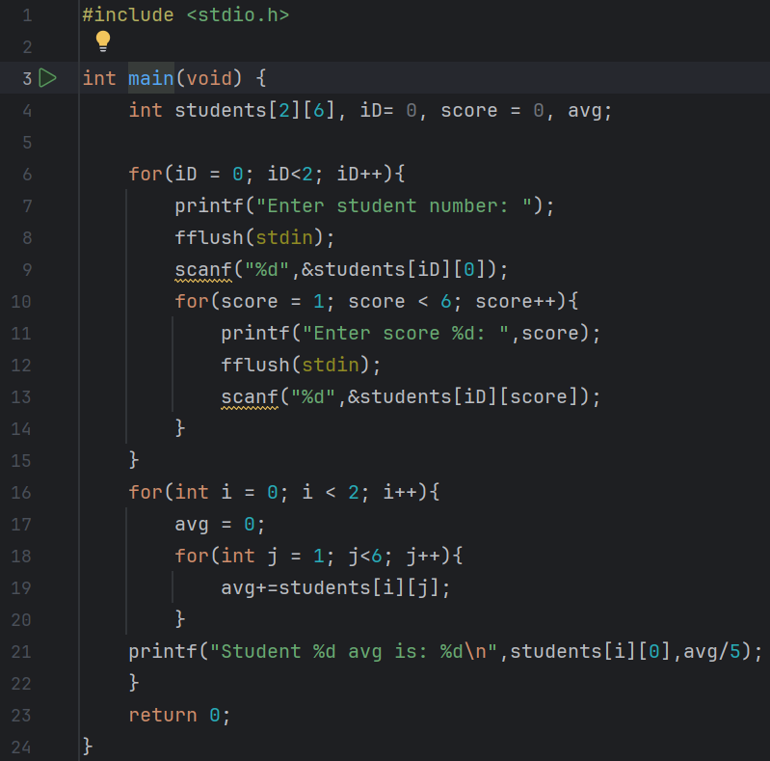
Predict
What do you think this code does?
Asks for the student number and than for 6 scores. After that asks again for a student number and again for 5 scores. After that it outputs the averages of the scores of both the students seperately.

Slide 3
Run
Download the code from Github and run it!
What does the code do?
Asks for the student number and than for 6 scores. After that asks again for a student number and again for 5 scores. After that it outputs the averages of the scores of both the students seperately.
Does this match your prediction?
Yes.

Slide 4
Investigate
Investigation Activities
What are the names of the variables being used? iD, score and average What data types do they hold? integers Annotate lines 4-23 to explain what each line of code does. Draw a table that shows the “shape” of the array. Label each cell of the table with how they would be indexed.

Slide 5
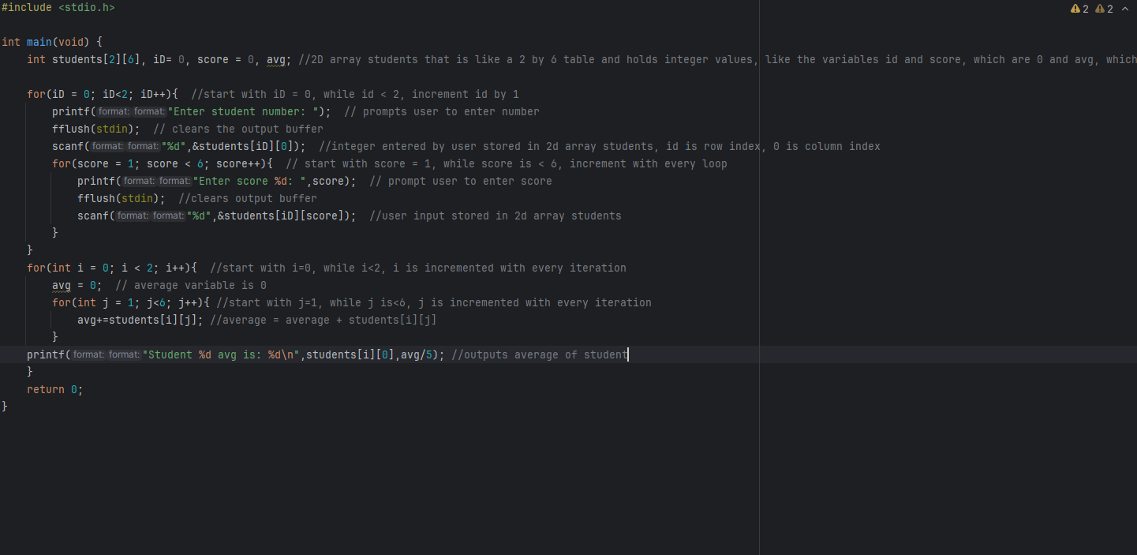

Slide 6
students[2][6]
row
0
1
2
3
4
5
Student number of first student Students[0][0] | Score 1 of student 1 Students[0][1] | Score 2 of student 1 Students[0][2] | Score 3 of student 1 Students[0][3] | Score 4 of student 1 Students[0][4] | Score 5 of student 1 Students[0][5]
Student number of second student Students[1][0] | Score 1 of student 2 Students[1][1] | Score 2 of student 2 Students[2][1] | Score 3 of student 2 Students[3][1] | Score 2 of student 2 Students[4][1] | Score 5 of student 2 Students[5][1]
0
column
1

Slide 7
Modify
Modification Activities
Edit the program so that 4 scores are stored. The program should then use a loop to show the user the outputs stated below: Requirements: The average score for each student is output to the user The program finds and shows: The highest score in the list, and which student achieved it The lowest score in the list, and which student achieved it

Slide 8
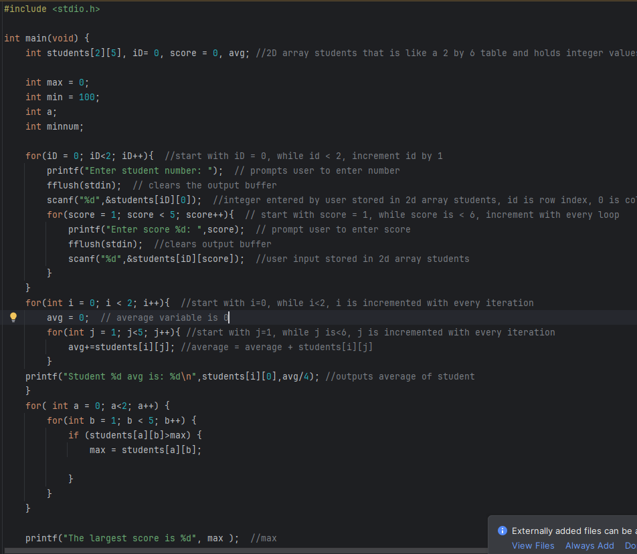
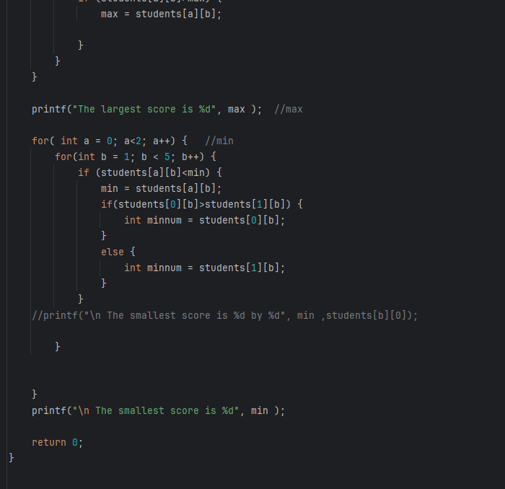

Slide 9
Make
Make Activities
Write a treasure finding game. Requirements: The program should randomly generate an X into a 2D array called map[10][10] The program should display the whole array as a grid, filled with hyphens (-’s) The user should guess coordinates to check e.g. 3,4 (row 3, col 4) The program should make sure the coordinates are in range (e.g. only 1-10) and get them to be re-entered if not The program should either display the map array with the X showing in the location (to show the treasure is found) OR Display a O to show the treasure isn’t there The user is allowed to keep guessing until the treasure is found

Slide 10
